Slide 1

PRESENTED BY- NEHA SHARMA (a2305314039)
SHUBHAM lekhwar (a2305314040)
DEEPANSHI singla (a2305314041)
BHUMIKA thareja (a2305314042)
SUBANSHU Jindal (a2305314043)
chiranjiv ravi shah (a2305314046)
shashank bijlwan (a2305314047)

Slide 2
Content- -What are biosensors? -Working process of biosensors or Biosensors system. -Placements of biosensors. - Types of biosensors. -Examples of biosensors. -Advantages and applications of biosensors. The end.

Slide 3
What are biosensors? ‘’These are devices which uses a living organism or biological molecules, especially enzymes or antibodies, to detect the presence of chemicals.’’
OR
A biosensor is an analytical device, used for the detection of an analyte, that combines a biological component with a physicochemical detector.

Slide 4
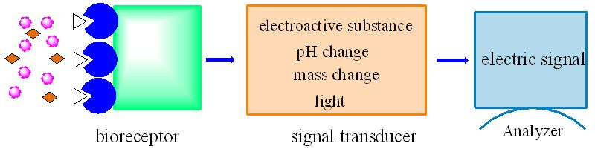
THE BIOSENSORS SYSTEM
Analyte diffuses from the solution to the surface of the Biosensor
Analyte reacts specifically & efficiently with the Biological Component of the Biosensor.
This reaction changes the physicochmical properties of the Transducer surface.
This leads to a change in the optical/electronic properties of the Transducer Surface.
The change in the optical/electronic properties is measured/converted into electrical signal, which is detected.

Slide 5
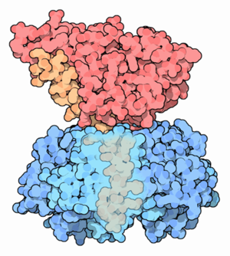
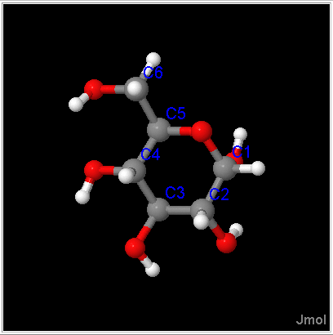

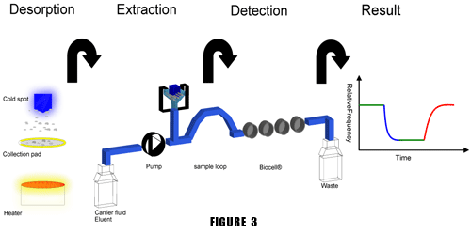
THE ANALYTE. (What do you want to detect?) Molecule Protein, toxin, peptide, vitamin, sugar, metal ion SAMPLE HANDLING. (How to deliver the Analyte to the Sensitive Region?) (Micro) fluidics Concentration (increase/decrease) Filtration/selection
Cholera toxin
Glucose

Slide 6
DETECTION/RECOGNITION.
(How do you specifically recognise the analyte?)
Fab
Active site
Membrane receptors
Competitive binding
Fc
Antibody
Enzyme
Cell
Polymer/Hydrogel

Slide 7
SIGNAL
(How do you know there was a detection?)
Common Signalling Principles
● Optical(SPR,ELM,IR).
● Electrical(Voltametry,Potentiometry,
Conductivity).
● Electromechanical(QCM).
● Thermal.
● Magnetic.
● Pressure.
Often the detector is immobilized on a solid support/sensor.
(The immobilisation permits repeated use of the costly Biological Molecule.)
Specific recognition?

Slide 8
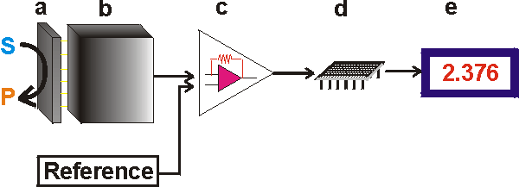
Figure below -- Schematic diagram showing the main components of a biosensor. The biocatalyst (a) converts the substrate to product. This reaction is determined by the transducer (b) which converts it to an electrical signal. The output from the transducer is amplified (c), processed (d) and displayed (e).

Slide 9
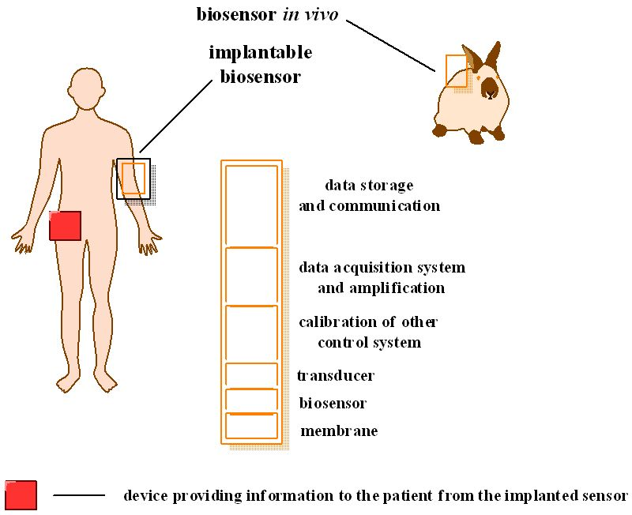
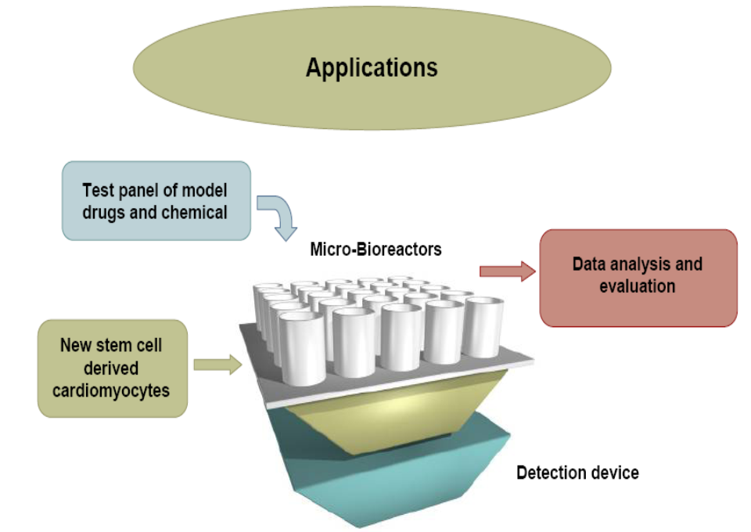
Placement of Biosensors
In-vivo: An in-vivo biosensor is one that functions inside the body. Biocompatibility concerns follow with the creation of an in-vivo biosensor.
In-vitro: An in-vitro biosensor is a sensor that takes place in a test tube, culture dish, or elsewhere outside a living organism.

Slide 10
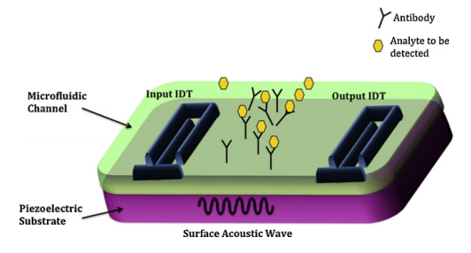
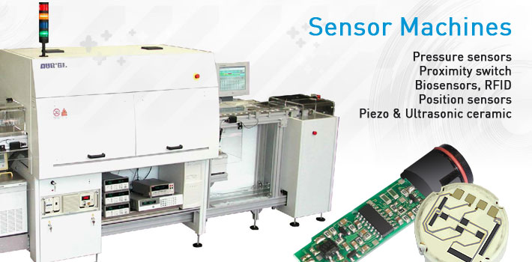
CONTI.
At-line: An at-line biosensor is used in a production line where a sample can be taken, tested, and a decision can be made whether or not the continuation of the production should occur.
In line: The biosensor can be placed within a production line to monitor a variable with continuous production and can be automated.
Point-of-concern: There is a challenge to create a biosensor that can be taken straight to the “point of concern”, that is the location where the test is needed.

Slide 11
TYPES OF BIOSENSORS
Calorimetric/Thermal Detection Biosensors.
Optical Biosensors.
Resonant Biosensors.
Piezoelectric Biosensors.
Ion Sensitive Biosensors.
Electrochemical Biosensors.
Conductimetric Sensors.
Amperometric Sensors.
Potentiometric Sensors.

Slide 12
Calorimetric Biosensors- If the enzyme catalyzed reaction is exothermic, two thermistors may be used to measure the difference in resistance between reactant and product and, hence, the analyte concentration.
Optical Biosensors
Colorimetric for color
Measure change in light adsorption
Photometric for light intensity
Photon output for a luminescent or fluorescent process can be detected with photomultiplier tubes or photodiode systems.

Slide 13
Potentiometric Biosensor For voltage: Change in distribution of charge is detected using ion-selective electrodes, such as pH-meters.
Electrochemical Biosensors
For applied current: Movement of e- in redox reactions detected when a potential is applied between two electrodes.
Piezo-Electric Biosensors
Piezo-electric devices use gold to detect the specific angle at which electron waves are emitted when the substance is exposed to laser light or crystals, such as quartz, which vibrate under the influence of an electric field.

Slide 14
BASIC CHARACTERESTICS
LINEARITY - Should be High – For the detection of High Substrate Concentration.
SENSITIVITY - Value of Electrode Response per Substrate Concentration.
SELECTIVITY - Chemical Interference must be minimised for obtaining Correct Result.
RESPONSE TIME – Time necessary for having 95% of the Response.

Slide 15
ADVANTAGES
Highly Specific.
Independent of Factors like stirring, pH, etc.
Linear response, Tiny & Biocompatible.
Easy to Use, Durable.
Require only Small Sample Volume.
Rapid, Accurate, Stable & Sterilizable.

Slide 16
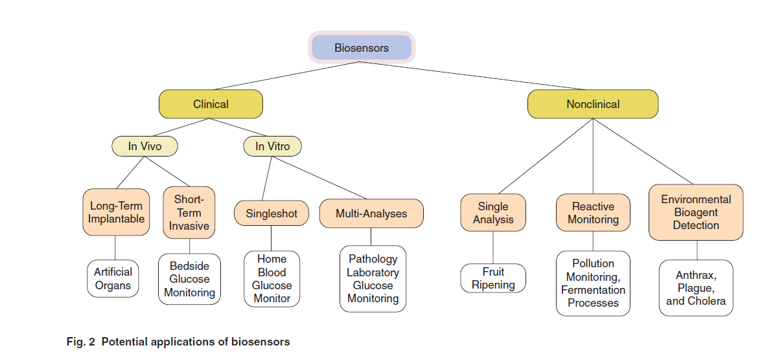
APPLICATIONS

Slide 17
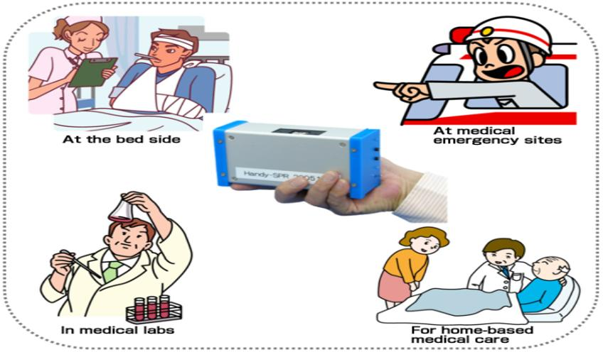
APPLICATIONS
Food Analysis.
Study of Biomolecules & their Interaction.
Drug Development.
Crime Detection.
Medical Diagnosis (Clin&Lab).
Environmental Field Monitoring.
Quality Control.
Industrial Process Control.
Detection Systems for Biological Warfare Agents.
Manf. Of Pharmaceuticals & Replacement organs
FOR AGRICULTURAL & FOOD INDUSTRY.

Slide 18
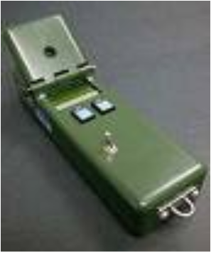
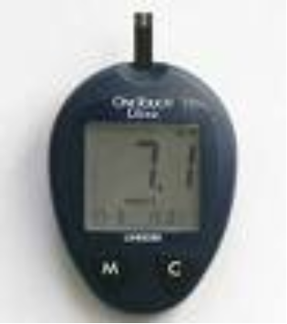

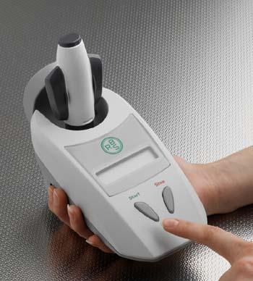
Pregnancy Test.
Detects the hCG protein in urine.
Interpretation and data analysis performed by the user.
Infectious Disease Biosensor.
Data analysis and interpretation performed by a microprocessor.
The DNA capture element instrument- for hereditary diseases
Glucometer- for measurement of glucose in blood.

Slide 19
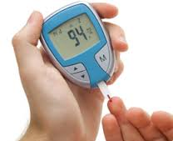
WORKING OF GLUCOSE METER
A common example of a commercial biosensor is the blood glucose biosensor, which uses the enzyme glucose oxidase to break blood glucose down. In doing so it first oxidizes glucose and uses two electrons to reduce the FAD (a component of the enzyme) to FADH2. This in turn is oxidized by the electrode in a number of steps. The resulting current is a measure of the concentration of glucose. In this case, the electrode is the transducer and the enzyme is the biologically active component.

Slide 20
CONCLUSION.
The trends in biosensor technology over the past 30 years have taken this equipment from simple and cheap components to the integration of several sensor systems into one unit including multiple analyses, making these systems smaller and tailored for mass production. The vision for the biosensor industry is to create micro scale technology that will be suitable for performing sample preparation, analysis and diagnosis all with one chip.
THANKYOU
THE END.

